Slide 1

GYM MANAGEMENT SYSTEM
PRESENTED TO:
MA’AM FARWA JAVED
PRESENTED BY:
SYEDA GHAZAL ZAHRA(462)
MAHAM HASEEB (153)
AMIR RAZZAQ (140)
ALI ABDUL GHAFFAR(135)
MUHAMMAD HASEEB (523)

Slide 2
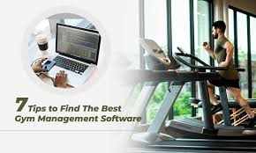
2
What Is “GYM MANAGEMENT
SYSTEM”
Gym management system is an easy-to-use gym and health club membership management system. It helps you keep records of your members and their memberships, and allows easy communication between you and your members.
Gym Management system is also feature-packed, helping you in the management and growth of your club.

Slide 3
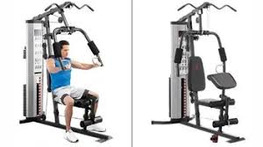
3
PUPOSE OF GYM MANAGEMENT SYSTEM
The objective of the Gym Management System is to provide a system which handles the information of the people coming into the gym and maintaining their health care. It takes care of all their health information. ... It also maintains the people's attendance, gym records.

Slide 4
Information about our project
4
This project is basically about the “GYM MANAGEMENT SYSTEM”.
In this project, we’ll take “Admissions & Attendance” of new client’s and trainer’s
.
In all this process, we’ve used different conditions like :-
If conditions.
If else.
Nested if-else.
Arrays.
Switch statement.
Goto statement.
We have used different data types like :-
Int.
Float
String
char

Slide 5
5
We have used following escape sequences :-
\t (for horizontal tab space)
\n ( go to next line)
lets see how it works
Following function keys are used to execute program.
Function key “f9” is used to compile the program...
Function key “f10” is used to run a program...
Function key “f11” is used to compile and run the program...

Slide 6
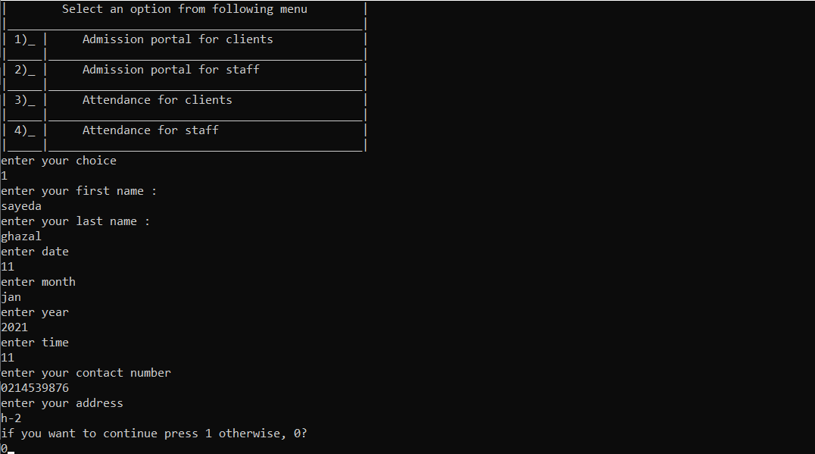
OUTUT OF THE PROGRAMM
6
Main menu of our Gym management system.

Slide 7
admission for the client
7

Slide 8
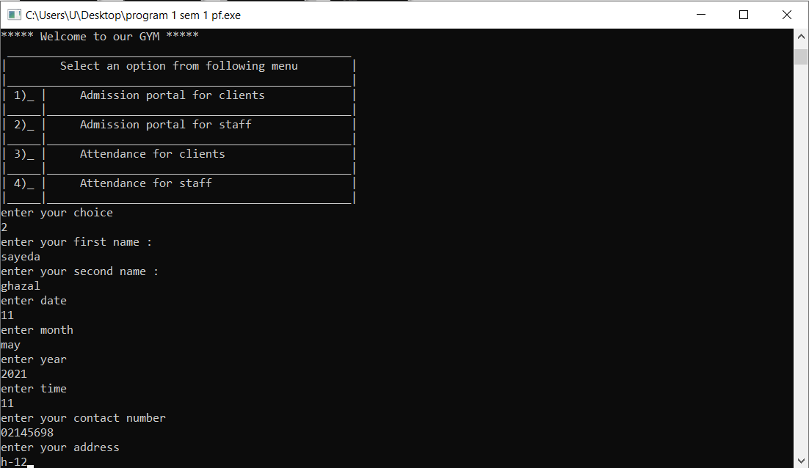
admisssion for trainer
8

Slide 9
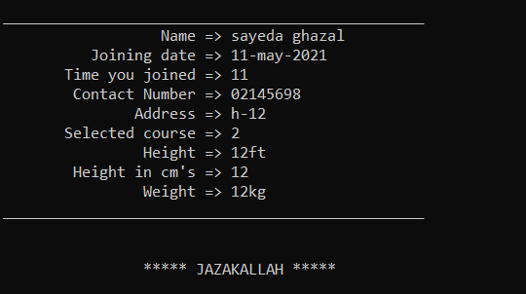
display admission form
9

Slide 10
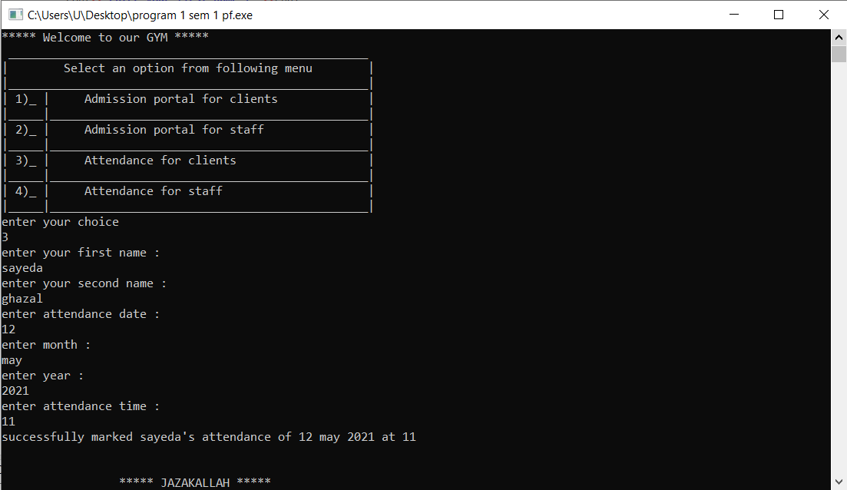
attendence for client
10

Slide 11


